Slide 1
Global Development India
Towards globally integrated team

Slide 2






Global Development India
Journey towards full global integration
Focus Area
Increase Scope
Provide Leadership
Global
Integration
Stabilize operations
2012
2011
Expand capabilities
Drive quality execution
2010
2001- 09
IGDF
DI: TAPAS (QA)
IIS: Full trial deliverables
DS&E: Cross Div. support
DRA: Responsibility for EM
TRD
PHAD: Established lab
CMC: Regulatory strategy
DSM: All LU2 label check
FRANCHISE: -
IGDF
ClinOps: Coms & Tams
DI: TAPAS (Clin. monitors)
IIS: Project Lead roles
DS&E: BSL role, HA Audit
DRA: GPRM, SRH roles
TRD
PHAD: Built to suite facility
CMC: Expanding strategy role
DSM: Trial manager role
FRANCHISE: CTH, GPTD, MSE
IGDF
ClinOps: Central Monitoring
DI: Argus 7, TAPAS, mobility, CAF
IIS: Excellence - Stats, Med writing
DS&E: Signal Detection and Epi role
DRA: Expansion, GPRD role
TRD
PHAD: GMP Lab work for all PDU’s
CMC: Global franchise teams
DSM: Trial planning capability
FRANCHISE: Regional footprint
Some
Examples
Of
Capability
Built across
LFs
Support Statistical Reporting, Data Management, Medical Writing, Regulatory Affairs and Drug Safety and Epidemiology functions

Slide 3
Development Team Across all LFs represented
Size Snapshot
Group | September 2011 HC
TRD (PHAD/DSM/RegCMC) | 106
IIS | 231
DS&E | 172
DRA | 88
DI | 73
GCO | 6
Clinical Franchise | 24
DSS/Mgmt/Admin | 3
Total | 703

Slide 4
Global Development India 2011 Achievements
Highlights ..... (1/2)
Line Function | Achievements
DRA | CDS compliance project is delivering as planned and will complete and dispatch all updates by December 2011 6 Global Program Regulatory Managers work for franchises and sit in DRA sub-teams from Hyderabad effective May 2011. Around 95% of all dossier publishing is from DRA operations group at Hyderabad
DI | TAPAS and new release of TAPAS with widened scope which includes support to Clinical Operations ADVANCE project deliveries, J-Review, LSH, TMS and Data Standards implementations led from Hyderabad.
IIS | Global Project Leads from Hyderabad established Global Heads for DB Programming and Translational Science Medical Writing CQA audit of DM positive DM Alliance model established Career path focusing on statistical scientists and programmers rolled out.
DS&E | Multiple audits and inspections with only minimal findings (Quantic, German Health Authority, EMA) Cross sector support for SANDOZ and NVD Global PVLs Flexible sourcing model (Project 24/7)
Clinical Franchises | Primary and Critical Care franchises for CVM, NSO, IHC and EM established teams in India by hiring CMs, CTHs, GPTDs and MSEs in India. CVM franchise has 3 associates in Critical Care and 8 in Primary Care , IHC has 2 CTHs and 2 CMs and NSO has 1 CTH and 2 CMs. Metabolism CoE launch (Nov 18,19) to connect with KOLs and build clinical research network planned

Slide 5
Global Development India 2011 Achievements
Highlights ..... (2/2)
Line Function | Achievements
TRD PHAD | Established TRD-PHAD analytical lab in India in September 2010 and achieved GMP status in Apr 2011. 53 staff hired On track to deliver 50+ projects
TRD Reg CMC | 96% Marketed portfolio writing, 60% Development portfolio writing Support the Marketed & Dev portfolio for AMAC expansion and simultaneous submissions Global Marketed Liaison role established
TRD DSM | Franchise alignment Established trial manager roles
Dev Education Office | Global Development Training Plans regularly implemented including Canyon Maps, Learning Maps, DD@N Leadership Development Programs for all levels (Talent Acceleration Program for 2 - 4 year experienced associates, Aspiring Leadership Program for first line managers and Advanced Leadership Program for senior managers) – local alternatives to Corporate programs M1 Trainers available locally in Hyderabad
Hyderabad Site | Robust associate engagement program – enLiven for creating better work environment, xChange for sharing of cross functional knowledge and Rainbow for giving back to society

Slide 6
Story till date ....
Development LF based out of Hyderabad are contributing meaningfully to global deliverables – both with respect to capabilities and capacity
Quality of work is in line with global expectations
Capacity build-up has been to target
Attrition being managed through various activities including career paths, career development and employee engagement programs
Going forward .... The story continues

Slide 7
Four Point Strategy for
Globally Integrated Development Organization
Initiatives being run out of Hyderabad
      GROWTH
      INNOVATION
      PRODUCTIVITY
GLOBALLY INTEGRATED
DEVELOPMENT ORGANIZATION
      SEAMLESS ABILITY TO ACCEPT POSITIONS OF INCREASING GLOBAL ACCOUNTABILITY IN HYDERABAD, SUPPORTED BY A STABLE, DEEP AND SUSTAINABLE TALENT POOL
Hire to LF specific HC
Clinical Franchise built-up
Central Monitoring
Central Analytics Function
Metabolism CoE launch
IIS: DM Alliance
DS&E: Project 24/7
TRD: PHAD analytics lab
      ESTABLISHMENT OF SPECIFIC CENTERS OF EXCELLENCE BASED ON FUNCTIONAL COMPETENCIES TO FULLY SUPPORT GLOBAL ORGANIZATION
      IN THE MID TO LONG TERM, THE GLOBAL DEVELOPMENT ORGANIZATION IN HYDERABAD SERVES AS A CATALYST TO ENHANCE FOCUS ON REGIONAL MEDICAL NEEDS AND EXPAND CLINICAL TRIAL ACTIVITY IN INDIA/REGION
Develop Global Leadership (DI ADVANCE, TAPAS; DS&E BSL activities; Reg CMC – Regulatory Liaison; DRA: GPRM; Clinical Franchise: GPTD, CTH; IIS – Project Leads)
Functional Excellence (Functional Expertise:- Part time PhD program; Pharmaceutical Medicine Sponsorship Program; Softskills Program through DEO)
Strategic Capacity Build (Hiring and Attrition Management; HR and LF alignment )
PEOPLE CAPABILITY AND CAPACITY ENHANCEMENT

Slide 8
Specific Examples of Development Initiatives
TRD PHAD Labs
Central Monitoring Team
Central Analytics Function

Slide 9
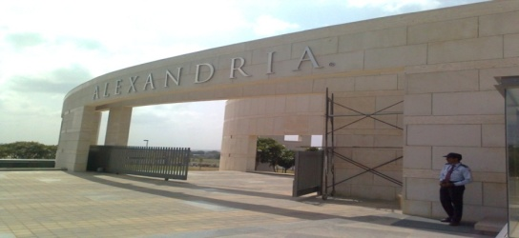
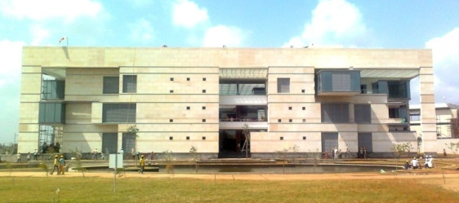
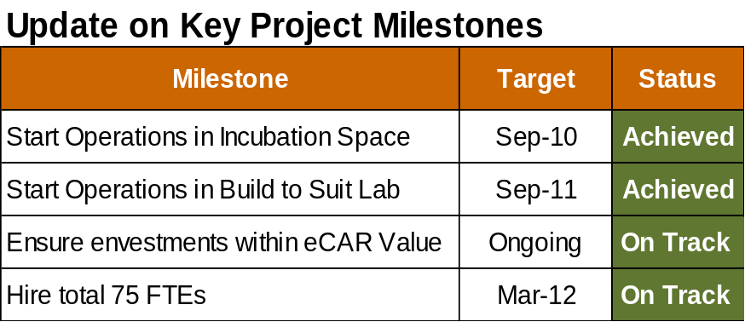
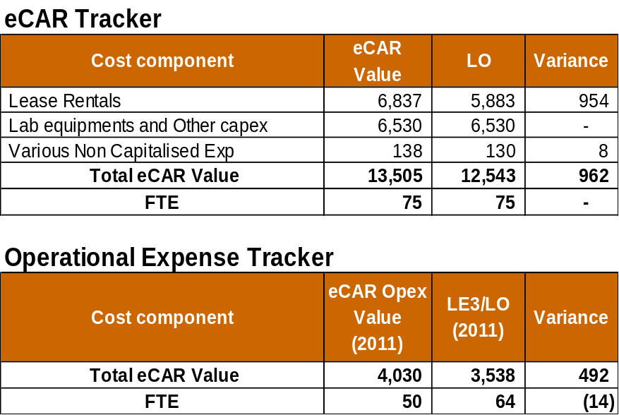
TRD-PHAD Labs
On track as per eCar
  All Major Project milestones are achieved as per eCAR and Business case
  All Local Regulatory/Statutory approvals are timely in place
  Built to suit Laboratory became operational in Sep 2011
  On track to hire total 75 FTEs by March 2012
  7% Savings (about $ 962k) are expected on eCAR value ~ mainly due to better lease rental negotiations with Lease partner Operational expenses are lower than Business case projections ~ mainly due to lower personnel and operational costs
  Current Laboratory Capex spend is in line with eCAR values
  Significant operational and procedural challenges experienced in importing used equipment’s from other Novartis Global sites ~ may result in increased Cpaex spend for purchase of Laboratory equipment's

Slide 10
Clinical Operations Support
Building Center of Excellence and Functional Expertise
FUNCTIONAL EXPERTISE
Objective:
Create a centre of excellence based in Hyderabad, India providing continuous remote monitoring for Post-Approval Safety Studies (PASS) and Observational trials, real time monitoring, quality, signal detection
Scope:
Ensure continuous monitoring for studies with limited number of patients visits and data sets, but high sample size. Need for collaboration with CPOs: Medical, Commercial and ICRO Country CRAs, Global Clinical Operations and Development Franchises.
Critical clinical operations positions based out of Hyderabad site
  COM and TAM roles
  COM supporting Gilenya PASS studies
  Administration of Clinadmin functionality
CoE
Central Monitoring Team
  Pilot on Gilenya PASS studies
  Use Data Analytic tools on Operational and patient level data to monitor site performance and track safety signals on an ongoing basis

Slide 11
Central Analytics Function
We have the tools to help drive knowledge-based decision making
KPIs and Metrics
IVRS
Clinical Trial Intelligence
Site Performance
Resource Management
CPP
Report Generation
Budget
CTMS
Central Labs
Trial Trove/Site Trove Databases
Pipeline Database
TA-scan or similar vendors
Master Investigator Database with performance metrics
Competitive Trial Designs and Timelines
Centralized Analytics Function
OC-RDC
ARGUS
Systems
J-Review
TAPAS
Tools
Compass
Decision
View
Identification of Safety Trends
Targeting Poor Performing Sites
Protocol Design & Compliance Trends
AE/SAE Profiles
Lab/ECG value changes across patient population
Patient profiles
Reasons for withdrawal
Potential conmed interactions
Query Rates
# Protocol Deviations/Violations per site
Data Outliers based on frequency trends (avg AE/subject)
Data “too consistent” demonstrating questionable data collection practices
Missing key safety & efficacy procedures
Deviations from procedural timing (e.g., infusion times)
Study Drug non-compliance
Screen Failure Rates
Event rates
Trip Report Review

Slide 12
Oncology Global Development & GMA is here .......

Slide 13
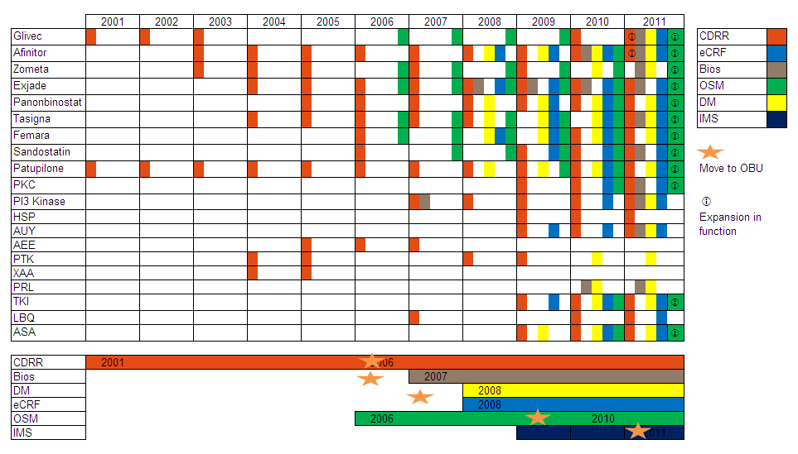
150 associates and growing, 3 new functions since 2008. supporting the development pipeline across all phases
Remove
More full names : Stats programming, bios , data mgmt, submission writing , medical safety. Combine DM, DM prg, check move to OBU for IMS, OSM. Jakavi missed
Add row for new LF Sci Comm
Or separate /magnify the lower as an fte graph ?graph
Remove
Fte growth to be shown
Add row for Sci Comm – 2012 33fte’s
We have Shared services with General Medicines Hyderabad in DRA, DSE, TRD, DI
Note : Project support information presented is not quantitative .

Slide 14
Hyderabad is an integral part of a seamless global organization with capabilities of technical, specialized expertise to support global business.
Hyderabad’s operational strategy is consistent with all geographic sites (FP, Basel, Paris and Tokyo) with clear definition of roles, responsibilities, and accountability
The Oncology growth strategy
Building a seamless global organization
Guiding Principles
FTE growth commensurate with pipeline, focus on improving productivity.
Outsourcing via FSP’s to cover peak periods
Quality, compliance, productivity driven through well qualified ,developed and trained internal staff and knowledge retained in NVS.
Leverage technology for productivity gains – standards , ADVANCE

Slide 15
Optional slide : Hyd teams work across all phases ? Footprint ...?
Vinay – any way to show the breadth of otm, cp, fd, gma work across all LF’s ?
Coming soon – gma scientifc comm team
Optional slide

Slide 16
Our aspiration is to build comparable functional capabilities as other global sites by 2015.
Success through Global Collaboration : Leadership, Planning, Implementation, Tracking . . .
Vision and Roadmap created & communicated for the largest teams - BDM. ( show example?)
Senior leadership endorsement and support
3 major ‘barriers’ have active workstreams : attracting, retaining talent , training & development.
A global steering committee monitors, guides progress
Status – well on track – some significant results and changes ?
Use maturity snapshot here ?

Slide 17
Example: increased submission capabilities
Vinay : from the start to now, growth in subm projects and higher types of work ?submission snapshot .
Mahesh, shruti SOM as a specific example – can be 1 slide – see gen meds examples ( slides for .

Slide 18
A Tough Passage / Flight
What we need ( Nara)
Can we have a pictorial repr ( ? Cartoon) of the challenges, needs... This table is very boring
Focus areas | What we need ?
Leadership : scientific / technical, business. | Better rotation policy / budget, Ability to attract high quality, overseas talent Cross functional exposure
Scientific knowledge & experience base | More strategic functions, roles Cross functional engagement Senior hires and rotations enabled Local mentors , sme’s developed Targeted training & development Retention planning
Work life balance | Ways to balance work pressure, learning / training needs
External focus & visibility | Knowing our patients Participation in external forums :conferences, associations , meetings

Slide 19

Key initiative / project showcase –e.g. IMS ?

Slide 20
Key projects showcase e.g. OSM ?

Slide 21
Key projects showcase e.g. COE programming ?

Slide 22
It’s all about the people

Slide 23
Summary slide – From : To style ?

Slide 24
Taglines for the cover /slides
Rejuvenating global team spirit ( Jean-marc, sylvie)
Struggles and striving come before success ....even in the dictionary ( Sylvie)
Achieving Success through Global Collaboration ( Nara)
Integrating for Global Development Excellence ( Nara)
Turning Global partnership into growth and success ( Nara)
In the relentless pursuit of excellence ( Nara)

Slide 25
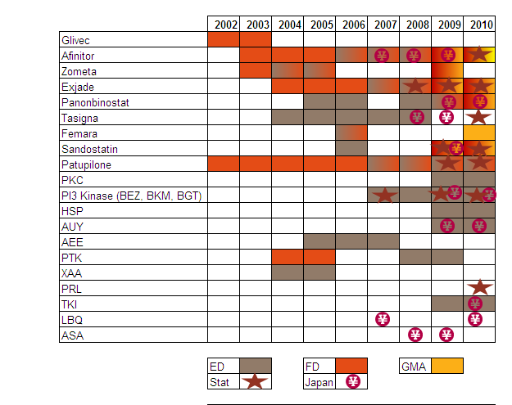
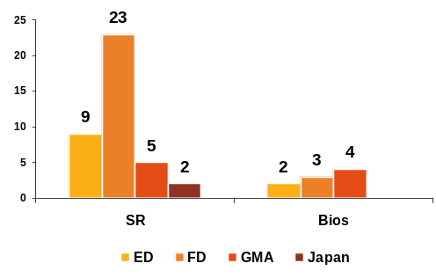
Oncology Biometrics has developed in new areas in the last 2 years
Highlights
Focus is on statistical reporting across all phases.
2009-10 has seen development in biostatistics

Slide 26


Apart from Science ......

Slide 27
One origin, measured growth & progress . . .
Notes:
SR maturity, biostatistics adds scientific vitality , ecrf , DM vital to the future DM strategy for Oncology – take charge of data quality in complex trails with new technology / ADVANCE , ecrf global coe strategy , OSM – close to 50 % in hyd . IMS med reveiw posied to learn from the gen meds experience ..... All phases reprsented
Novartis Global Oncology 2010 Miami
Tues_HerveHoppenot_Miami_Open_Plenary.ppt

Slide 28

The BDM Hyd Vision & Roadmap 2010-2015 is an integral part of global strategy
Approved by the BDM LT and Development Head
Monitored by a global steering committee
The main objective :
India is an integral part of a seamless BDM global organization with capabilities of technical, specialized expertise to support global business. India’s operational strategy is consistent with all geographic sites (FP, Basel, Paris and Tokyo) with clear definition of roles, responsibilities, and accountability.
Full Statistical reporting, Data management capabilities with job roles at trial, project level represented in India.
Full capabilities for biostatistics job roles at trial, indication level are represented in India.
Notes:
3 special aspects for project level role esp PS apart from the high level of experience, expertise:
close interaction in GPT ( regulatory, clinical, commercial)
Business understanding of the compound profile ( CDP, TPP) to successfully apply BDM processes
Interaction with HA’s – defend , interpret analyses , ,meet to devise strategies for a program.
Novartis Global Oncology 2010 Miami
Tues_HerveHoppenot_Miami_Open_Plenary.ppt

Slide 29
Highlights of progress : August 2011 Steering Committee
Capabilities focus : depth in role development, including managers.
Strategic elements remain largely unchanged
Key barriers : Attracting new talent , Training & Development still key to success.
Steering Committee : Success will be when global teams can work seamlessly relying on counterparts globally to meet expectations of their roles with quality and efficiency.

Slide 30
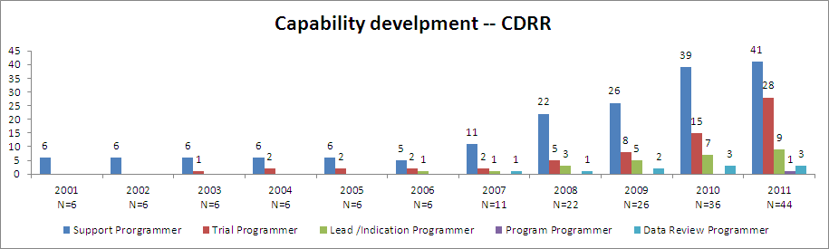
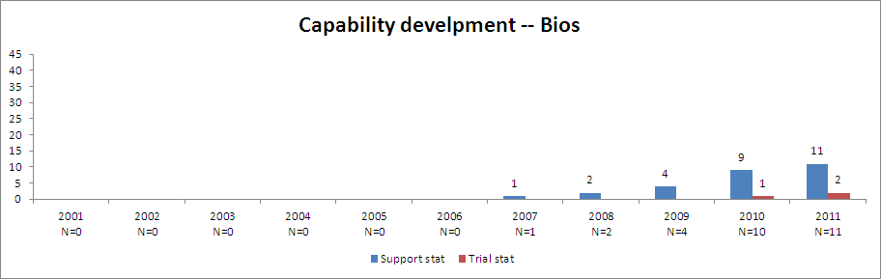
Capability development:significant results in the last 2 years
Notes:
9 of 11 are trial stats but only 5 are at 50 % proficiency level .
Novartis Global Oncology 2010 Miami
Tues_HerveHoppenot_Miami_Open_Plenary.ppt

Slide 31
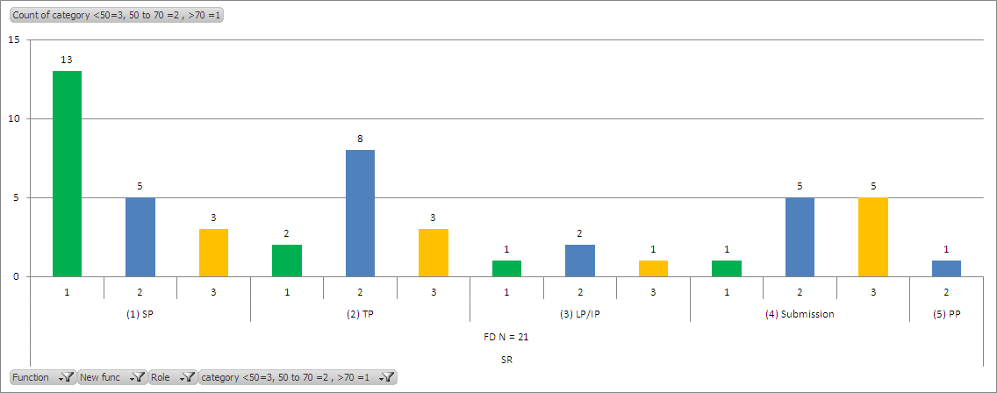
In depth examination of capabilities in Full Development Statistical programming .
>70 | 50-70 | <50
Has worked on most of the aspects of that role | Can handle tasks independently under supervision | New starter or just beginning with a new role
Independent decision maker | Can lead task level activities | Getting used to the processes and responsibilities required for the role
Can influence teams | Strong technical/analytical capability | Adequate technical and/or scientific understanding
Is able to understand complex studies and provide solutions | Good communication skills within function
Is able to multitask efficiently
Has a very good view of the next role and can move seamlessly in to the next level with minimum supervision
Strong communication and negotiations within and across functions
Notes:
Novartis Global Oncology 2010 Miami
Tues_HerveHoppenot_Miami_Open_Plenary.ppt

Slide 32
Biometrics - Roadmap 2015 (SR 1) – Version 1.2
2010
2011 Present capabilities
2012 - 2013
2014 - 2015
Beyond 2015
CP (n=4)
  Standard PK + safety
  Few PD studies
  TP role + RAP development
OTM ( n=3)
  Standard safety
  Few exploratory analyses
  Programming support
FD (n=14.5)
  TP role
  Standard safety
  ad hoc submission exp
CP (n=6)
  Lead programmer – start, under supervision,1-2ftes.
  Submission support, task level
  TP – eligible associates as per global criteria
  PD studies, non-standard PK, QT – start
  OTM (n=8)
  Lead programmer – start, under supervision.
  TP – eligible associates as per global criteria
  Biomarkers – start, build to reach 1 full FTE.
FD (n=35)
  TP – at least one for each project supported by India, new within global timelines.
  Indication programmer – start under supervision.
  Submission support – start build capabilities
CP
Lead programmer – 2-4 FTE
Submission support – full range of tasks- 2 FTE
PD studies, non-standard PK, QT – full
OTM
  Lead programmer – 2-3 FTE
  Biomarkers – steady contribution
  FD
  Indication programmer – 2-4 FTE
  Submission support – 4-5 associates with full range of tasks.
CP (n=6)
  Full capabilities in line with global
OTM (n=4)
  Programming – full capabilities in line with global
  Biomarkers – expertise
FD (n=21)
  Full capabilities – mix as in global at trial level, representation at indication level.
All
  Full capabilities – same as global at trial level , representation at indication levels, support at project level.

Slide 33
Biometrics - Roadmap 2015 (SR 2) – Version 1.2
Present Capabilities
2010 - 2011
2012 - 2013
2014 - 2015
Beyond 2015
GMA (n=6)
  Programming support
  Limited contrib to pubs/presentations
Other (n=1.5)
  Japan - 1.5 FTE
  China – ad hoc
  CRO – initiated 2 OSC
GMA (n=10)
  TP role – start
  Enhance support for pubs/presentations
  Lead programmer – develop existing resource .
  Data mining/graphics – start
Other
  Japan – 2 FTE
  China – align resources to plan.
  CRO – 4-5 OSC, pilot FSP
GMA
  TP role – fully achieve
  Pubs support – pref. loc.; collab with med writing
  Lead programmer – 2-3 FTE
  Data mining/graphics – steady contribution.
Other
  Japan – 3-4 FTE
  China – meet plan objectives, leadership from India .
  CRO – 2-3 FSP projects
  Standards - start
GMA (n=10+ 4?)
  Full capabilities for projects
  Data mining/graphics – towards center of excellence
Other (n=4 )
  Japan – preferred partner
  China-dedicated programming center in India.
  CRO – steady support to FSP model. Leadership established.
  Standards – steady rotation into standards group
All
  Full capabilities – same as global

Slide 34
Biometrics - Roadmap 2015 (Biostatistics) – Version 1.2
Present Capabilities
2010 - 2011
2012 - 2013
2014 - 2015
Beyond 2015
CP (n=2)
  Standard PK – RAP and FIR
  TS – limited protocol dev, under supervision
OTM
  None
FD (n=1)
  Started TS role – RAP, protocol amendments
  Limited protocol dev
GMA (n=4)
  Started TS – RAP, protocol amendment
  Support stat role
  MACS review
  Limited contrib to pubs/presentations
CP (n=2)
  TS – full role, including protocol dev under supervision .
OTM (n=1)
  Start supporting stat role, RAP,CSR, input to protocol, protocol amendments-TS level tasks under supervision.
FD (n=3)
  TS – full role – 2 FTE
  OPRC review (Mahesh)
GMA (n=4)
  TS – full role (1-2fte’s)
  Enhance support for pubs/presentations
  Exploratory analysis – start
Other
  Start scientific contribution
CP
  TS role – consolidate 2-3 fte’s
  LS role – start under supervision
  Non-standard PK, PD, QT studies
OTM
  TS role – ?start
  Biomarkers – ad-hoc, define plan.
FD
  TS role – consolidate
  Submission support – 1-2 FTE
GMA
  TS role – fully achieve
  IS role – start in 1-2 fte ‘s ?
  Pubs support – pref. loc.; collab with med writing
  Data mining/exploratory analysis – enhance
Other
  Scientific contribution – enhance
CP (n=4)
  Full capabilities at trial level
  OTM (n=2 ?)
  TS – full role
  Biomarkers – steady contribution, to plan
FD (n=?4)
  TS – full role
  IS role – start
  Submission support – 2 FTE
GMA (n=6)
  IS role – enhance
  Pubs support – towards center of excellence
  Data mining/exploratory analyses – full role
Other
  Strong steady contribution – methodology
All
  Full capabilities for TS/IS role
  Few FTE’s at level to provide submission, project support
  Few FTE’s with strong methodology contrib.

Slide 35
Data Management - Roadmap 2015 (Data Management) – Version 1.2
EDC + CRO
EDC + CRO
EDC + CRO + ASP + OC
CRO + ASP + OC
CRO + ASP + OC
CRO + ASP + OC
Present Capabilities
2010 - 2011
2011 - 2012
2012 – 2013
2013 – 2014
2014 – 2015
Trial Conduct
Data review and
Cleaning for in-house
and CRO trials
3rd party data
reconciliation
Assist in DB locks
SME Development
SMEs to deliver
training for identified
topics
Study Startup
  UAT
  3rd party DTS review
  DBL
  Support DBL
  preparation activities
  Trial Management
  TDM role for small
  CRO/ASP trials (~3
  new studies per yr)
  under supervision
  SME Development
  Training coordinator to facilitate competency build
Study Startup
Protocol review
eCRF authoring
VAP authoring
Developing eCCGs
DBL
Manage DBL
Activities
Trial Management
TDM role for small
CRO/ASP trials
Role development
TDM role on moderately
complex trials
Support trials
outsourced in China
Develop coding
capabilities
Independent TDM
role established
TDM role for large
trials
Full DM capabilities
(managing all DM
activities for ~20
studies)
Coding group well
established
Explore possibilities
to develop PDMs
Standards
Support review and implementation
SMEs and TDMs in the next five years
4 SMEs (task based) 8 SMEs and 4 TDMs (under supervision) 6 TDMs 8 TDMs 10 TDMs
Estimated HC figures for the next five years
16 DMs 22 DMs 27 DMs 27-30 DMs

Slide 36
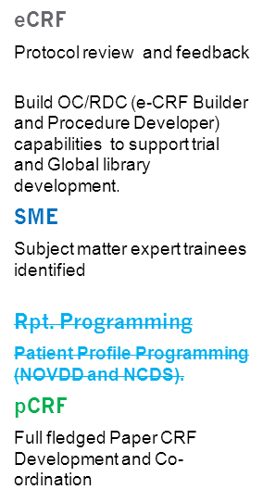
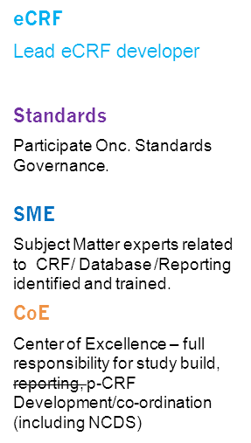
Data Management - Roadmap 2015 (Database Programming ) – Version 1.2
EDC + CRO
EDC + CRO
EDC + CRO + OC
EDC+ CRO + OC
CRO + OC
CRO + OC
Present Capabilities
2010 - 2011
2011 - 2012
2012 – 2013
2013 – 2014
2014 – 2015
eCRF
Novartis EDC – setup and maintenance – including
Japan (2 FTE)
CT4 setup for Novartis EDC and CRO studies.
Annotations and Database specifications for CRO studies
Creation of 3rd Party DTS template
Rpt. Programming
Report Programming (Protocol Deviation and Data Review reports) including Japan trials
pCRF
Paper CRF Development and co-ordination (excluding Basel specific process).
eCRF
Global Librarian role
Content development
Standards
Represent in Onc. Standards Governance on a rotation basis.
SME
Subject Matter experts nominated
Local Training and Mentoring support.
Program e-CRF Developers assigned
Local supervision programming activities at local CRO
CoE
Full fledged Center of Excellence for system and process.
Support China and Japan end to end
Responsibility for GMA trials.
Represent in Core Standard Governance on a rotation basis.
SMEs and program eCRF developers in the next five years
3 SMEs (task based) progress to build 2-3 full fledged SMEs 2-3 Prog eCRF developers
Estimated HC figures for the next five years
7 (pCRF,eCRF,Rpt prg) 15 20 ~ 20 - 22

Slide 37
Data Management - Roadmap 2015 (Data Management) – Version 1.0
EDC + CRO
EDC + CRO
EDC + CRO + ASP + OC
CRO + ASP + OC
CRO + ASP + OC
CRO + ASP + OC
Present Capabilities
2010 - 2011
2011 - 2012
2012 – 2013
2013 – 2014
2014 – 2015
Study Startup
  UAT
  3rd party DTS review
  DBL
  Support DBL
  preparation activities
  Trial Management
  TDM role for small
  CRO/ASP trials (~3
  new studies per yr)
  under supervision
  SME Development
  Trainer hired to
  enhance SME
  capability
Study Startup
Protocol review
eCRF authoring
VAP authoring
Developing eCCGs
DBL
Manage DBL
Activities
Trial Management
TDM role for small
CRO/ASP trials
Role development
TDM role on moderately
complex trials
Support trials
outsourced in China
Develop coding
capabilities
Independent TDM
role established
TDM role for large
trials
Full DM capabilities
(managing all DM
activities for ~20
studies)
Coding group well
established
Explore possibilities
to develop PDMs
SMEs and TDMs in the next five years
4 SMEs (task based) 8 SMEs and 4 TDMs (under supervision) 6 TDMs 8 TDMs 10 TDMs
Estimated HC figures for the next five years
16 DMs 22 DMs 27 DMs 27-30 DMs

Slide 38
Data Management - Roadmap 2015 (Database Programming ) – Version 1.0
EDC + CRO
EDC + CRO
EDC + CRO + OC
EDC+ CRO + OC
CRO + OC
CRO + OC
Present Capabilities
2010 - 2011
2011 - 2012
2012 – 2013
2013 – 2014
2014 – 2015
eCRF
Novartis EDC – setup and maintenance – including
Japan (2 FTE)
CT4 setup for Novartis EDC and CRO studies.
Annotations and Database specifications for CRO studies
Creation of 3rd Party DTS template
Rpt. Programming
Report Programming (Protocol Deviation and Data Review reports) including Japan trials
pCRF
Paper CRF Development and co-ordination (excluding Basel specific process).
eCRF
Protocol review and feedback
Build OC/RDC (e-CRF Builder and Procedure Developer) capabilities to support trial and Global library development.
SME
Subject matter expert trainees identified
Rpt. Programming
Patient Profile Programming (NOVDD and NCDS).
pCRF
Full fledged Paper CRF Development and Co-ordination
eCRF
Global Library including data modeling
Standards
Represent in Onc. Standards Governance on a rotation basis.
SME
Subject Matter experts nominated
Local Training and Mentoring support.
Standards
Participate Onc. Standards Governance.
SME
Subject Matter experts related to CRF/ Database /Reporting identified and trained.
CoE
Center of Excellence – full responsibility for study build, reporting, p-CRF Development/co-ordination (including NCDS)
Program e-CRF Developers assigned
Local supervision programming activities at local CRO
CoE
Full fledged Center of Excellence for system and process.
Support China and Japan end to end
Responsibility for GMA trials.
Represent in Core Standard Governance on a rotation basis.
SMEs and program eCRF developers in the next five years
3 SMEs (task based) progress to build 2-3 full fledged SMEs 2-3 Prog eCRF developers
Estimated HC figures for the next five years
7 (pCRF,eCRF,Rpt prg) 15 20 ~ 20 - 22

Slide 39
Road-map tracker – CDRR FD 2011
Group | Key Competencies | Way forward
FD TP – at least one for each project supported by India, new within global timelines. Indication programmer – start under supervision. Submission support – start build capabilities | Trial Programmer Managing timelines and milestones Ensuring all the study documents are reviewed and inputs have been provided and the documents updated in CREDI. Ensure SOPs and GPS processes are being followed Interact with the TS, TDM and clinical team for study related tasks Managing and assigning the tasks to the support programmers and point of contact within cross functional teams Communication and close interaction with IP and PP. Indication Programmer (in addition to supporting the TP in above activities) Resourcing / planning timelines for delivery Communication/co-ordination across functions Managing CROs Mentoring Negotiations Ensuring that the MAP is updated in close coordination with TP and PP. Program Programmer (in addition to supporting the IP in above activities) Manage programmers functionally across studies, indications and sites. Coach, build and develop scientific excellence Adherence to quality and best practices across all the indications with in the program Adequate representation and communication of SR issues at the level of the International Clinical Team. Induct, supervise (matrix) and train programmers on programming skills, trial and project level activities, and internal processes. Build and lead teams to address non-clinical project issues as assessed by Steering committees/and or Unit Manager Manage timelines, quality and preparation of CDRR deliverables and ensure that they comply with BDM, Oncology TA and regulatory guidelines globally for projects *The roles and responsibilities of the PP and IP may vary depending up on the magnitude of the project/indication. Submission support Advanced SAS skills / domain knowledge Contributions to the pooling plans Work under crunched timelines | More TP roles can be taken on More IP roles to be identified Submission activities full range of activities
On track:
TP roles across each project
IP / PP role have begun
Key contributions to submission activities at task level
Areas to work on:
Key contributions to submission activities at task level

Slide 40
Gen Meds

Slide 41
Thank You

